Slide 1
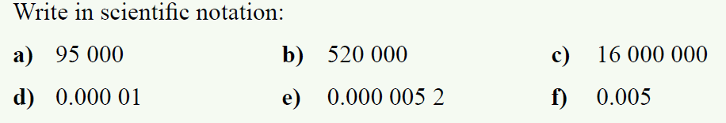
24
7
30
Date 8/11
Topic : Relative Frequency
EQ – How do relative frequencies allow us to predict results?
Steps to be successful this lesson:
Get materials out (notebook, pen, pencil, ruler, calculator)
Rule up notebook and write Topic and EQ
Start on review questions →
Check your answers with someone sitting next to you
Is your notebook up to date? (Contents page, glossary, review notes etc.)
Riddle: I am a number with a couple of friends, quarter a dozen, and you'll find me again. What am I?
Notes:
Answer is 3

Slide 2
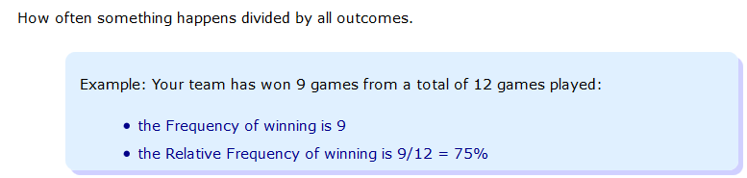
24
7
30
Topic : Relative Frequency
EQ – How do relative frequencies allow us to predict results?
Relative frequency = $\frac{Number of times an outcome occurs}{total number of outcomes}$
What is relative frequency?

Slide 3
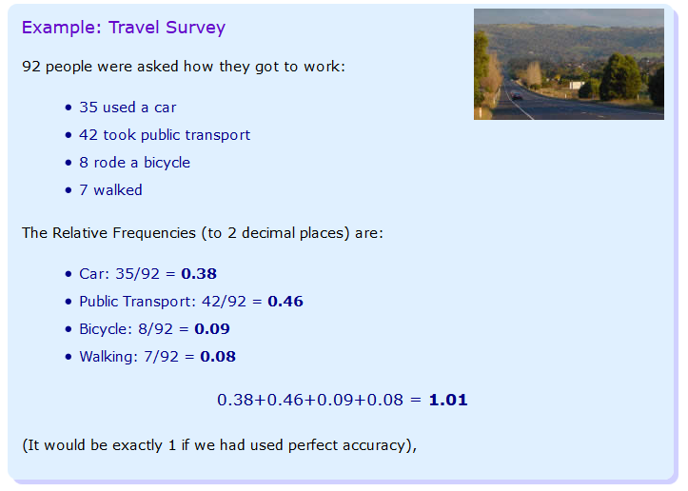

Slide 4

There is a lot of media attention on homelessness in Australia in today’s media. What is the relative frequency that an Australian is homeless complared to other nations. (Figures are from https://homelessworldcup.org/homelessness-statistics/)

Slide 5
24
7
30
Topic : Relative Frequency
EQ – How do relative frequencies allow us to predict results?
Relative frequency = $\frac{Number of times an outcome occurs}{total number of outcomes}$
Rule up this table in your INB
Country | Homeless | Population | Relative Frequency of Homelessness | % of Population (x100)
Australia | 105,000 | 23,490,700
India | 78,000,000 | 1,260,000,000
England | 112,070 | 53,500,000
France | 141,000 | 66,836,154
Germany | 284,000 | 80,219,695
Canada | 235,000 | 35,540,400
Guatemala | 475,000 | 15,853,144
USA | 610,042 | 319,000,000

Slide 6
24
7
30
Topic : Relative Frequency
EQ – How do relative frequencies allow us to predict results?
Country | Homeless | Population | Relative Frequency of Homelessness | % of Population (x100)
Australia | 105,000 | 23,490,700 | = 105000 ÷ 23490700 = 0.0045 | 0.45% of Australia
India | 78,000,000 | 1,260,000,000 | = 78000000 ÷ 126000000 = 0.0619 | 6.19% of India
England | 112,070 | 53,500,000
France | 141,000 | 66,836,154
Germany | 284,000 | 80,219,695
Canada | 235,000 | 35,540,400
Guatemala | 475,000 | 15,853,144
USA | 610,042 | 319,000,000

Slide 7
24
7
30
Topic : Relative Frequency
EQ – How do relative frequencies allow us to predict results?
Country | Homeless | Population | Relative Frequency of Homelessness | % of Population (x100)
Australia | 105,000 | 23,490,700 | = 105000 ÷ 23490700 = 0.0045 | 0.45% of Australia
India | 78,000,000 | 1,260,000,000 | = 78000000 ÷ 126000000 = 0.0619 | 6.19% of India
England | 112,070 | 53,500,000 | = 112070 ÷ 53500000 = 0.0021 | 0.21% of England
France | 141,000 | 66,836,154 | = 141000 ÷ 66836154 = 0.0021 | 0.21% of France
Germany | 284,000 | 80,219,695 | = 284000 ÷ 80219695 = 0.0035 | 0.35% of Germany=
Canada | 235,000 | 35,540,400 | = 235000 ÷ 35540400 = 0.0066 | 0.66% of Canada
Guatemala | 475,000 | 15,853,144 | = 475000 ÷ 15853144 = 0.0300 | 3% of Guatemala
USA | 610,042 | 319,000,000 | = 610042 ÷ 319000000 = 0.0019 | 0.19% of USA
The reason we use the relative frequency, is we can compare like to like, where as comparing raw numbers would not give a true and reflective idea of scale – there is 742.86 times as many homeless people in India when compared to Australia, however, there is only 5.74% more RELATIVE to their population size, which is ~53 times larger than Australia.

Slide 8
Activity
Create a table showing the relative frequency of cars for each category.
Car cost | Tally | Frequency | Relative Frequency
Less that $10,000
$10,000 to $19,999
$20,000 to $29,999
$30,000 to $39,999
$40,000 to $49,999
Over $50,000
 | Total =
Use the relative frequencies above to answer the following.
What is the probability that a car costs less than $10,000?
What is the chance that a car costs less than $30,000?
What is the likelihood that a car costs between $20,000 and $40,000
If a internet site has 4,000 cars for sale, use the relative frequencies above to predict the number of cars for each category.
Notes:
Use car listings ppt for a list of cars to use for this activity.

Slide 9
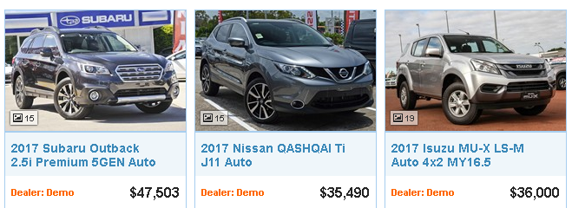
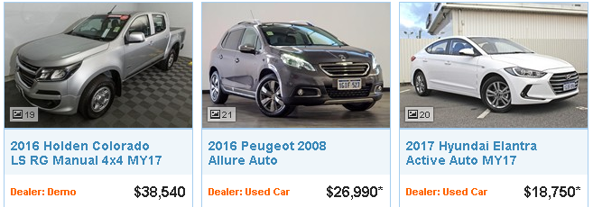
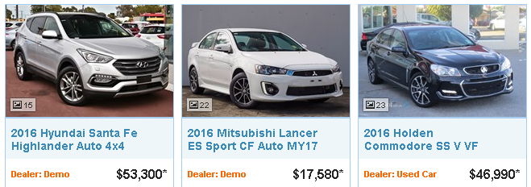


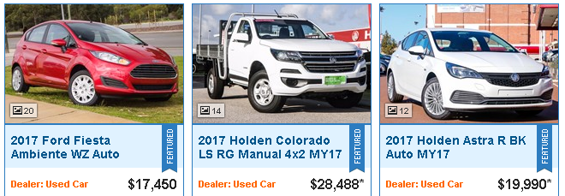
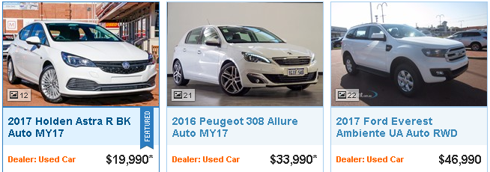


Slide 10
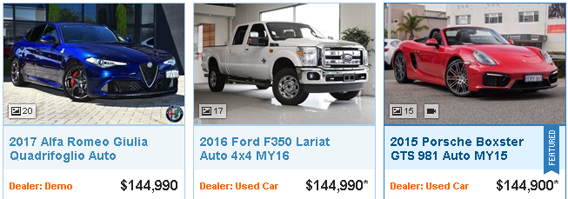
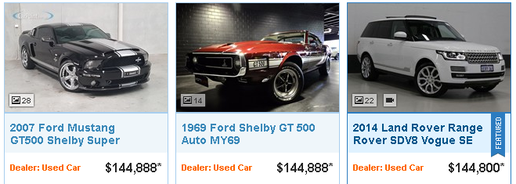
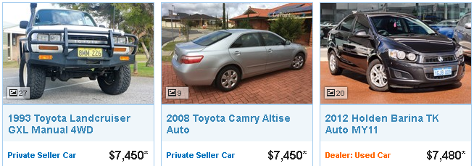
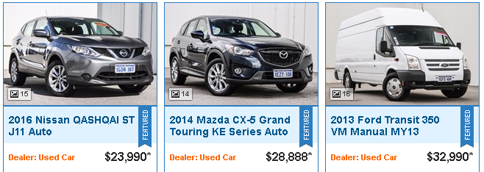
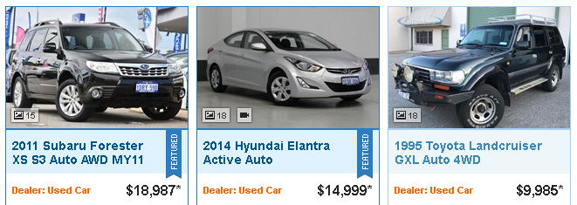
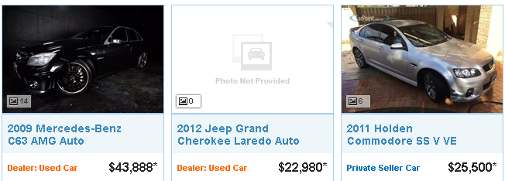
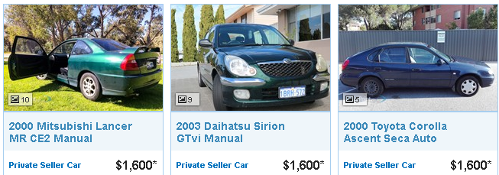


Slide 11
So,
How do relative frequencies allow us to predict results?

